Slide 1


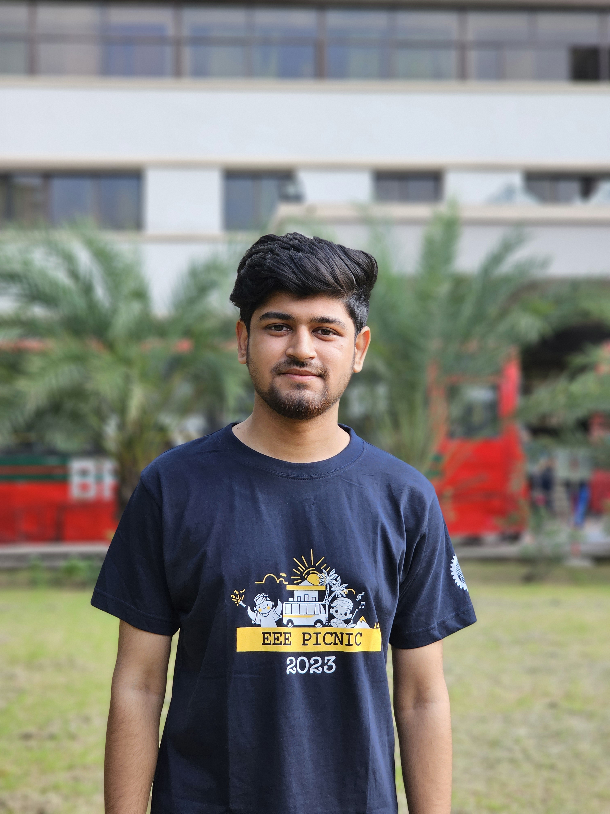

Design of a Class-A Common-Emitter RF Power Amplifier for the 433 MHz ISM Band
EEE 466 – Analog Integrated Circuits and Design Laboratory
Jan 2025 Level-4 Term-I Electronics G2
Final Project Presentation
Group- 04
Date : July 29,2025
Ilias Ahmad
2006068
Mohammad Al Hosan
2006090
Shohan Ahmed Rifat
2006116
Md. Alamgir Islam
2006122

Slide 2
Outline
Abstract
Introduction
Design Analysis
Design Methods
Design: Simulation
Implementation: Demonstration
Novelty
Future Work
CO/PO
References
Presented by: 20060122

Slide 3
1. Abstract
Designed a Class-A common-emitter RF power amplifier targeting the 433 MHz ISM band.
Used inductor-integration to restrict AC power flow and an impedance matching network for stable operation.
Performed circuit simulation in Cadence to validate performance metrics.
Achieved Power Gain of 10.1138 dB and PAE of 7.52%, demonstrating effective design.
Presented by: 20060122

Slide 4
2 Introduction
ISM band (433 MHz) is popular for license-free, short-range communication.
RF Power Amplifiers are critical in wireless systems, used to boost signal strength.
Class-A amplifiers offer linearity but are less efficient, requiring optimized bias and matching.
Our project aligns with applications like wireless sensor nodes and RF transmitters.
Presented by: 20060122

Slide 5
3.1 Design: Identification of Scope
Parameter | Value
Topology | Common-Emitter (CE)
Frequency | 433 MHz
Gain | ≥ 10 dB
Power-Added Efficiency (PAE) | ≥ 5%
Saturation Power (Psat) | ≥ 17 dBm
Technology | gpdk090 or tsmc18
Presented by: 20060122

Slide 6
3.2 Literature Review
İsa Kocakarin (Istanbul, 2011): In his B.Sc. thesis, Kocakarin explores RF amplifier design at 433 MHz using a Class-A Topology .The study emphasizes optimization of gain and stability, achieving over 30 dBm output with low noise and efficient power transfer.
NXP Semiconductors (2014): In their Application Note AN11504, NXP presents a detailed design for the BFU590Q transistor-based RF amplifier targeted at the 433 MHz ISM band. It covers key aspects such as gain optimization and impedance matching, critical for ISM applications.
Analog Devices (2003): The RF Power Amplifier Design Notes highlight design challenges in RF amplifiers, focusing on load-line theory, matching network design, and efficiency. These notes are essential for understanding amplifier architectures and the trade-offs between linearity and power efficiency.
Presented by: 20060122

Slide 7
3.3 Design: Problem Formulation (PO(b))
Design Requirement/Challenge | Details
Amplification Goals | Achieve minimum gain of 10 dB and Psat ≥ 17 dBm, with PAE ≥ 5% for efficient signal amplification.
Design Topology | Class-A Common-Emitter topology for linear amplification suitable for the ISM band.
Biasing and Stability | Inductor-based biasing for low noise and stability, ensuring reliable operation under varying conditions.
Impedance Matching | Ensure input/output matching to a 50Ω system with input return loss < -10 dB and output return loss < -20 dB.
Simulation and Validation | Use Cadence and QUCS Studio to simulate and validate performance metrics like gain, PAE, and impedance matching.
EEE 466 (2025) –Project Group 04
Presented by: 20060122

Slide 8
3.2 Design Methods (PO(a))
1. Circuit Selection
5. Design Matching
Network in QUCS Studio
2. Simulation in Cadence ,Virtuoso
6. Simulate with Matching
Network in Cadence
3. Adjusting Q point
7. Adjust and Finalize
Design in Cadence
4. Extract S-parameters
(from Cadence Virtuoso)
Presented by: 20060068

Slide 9
Design: Simulation & Implementation: Demonstration
Presented by: 20060068

Slide 10
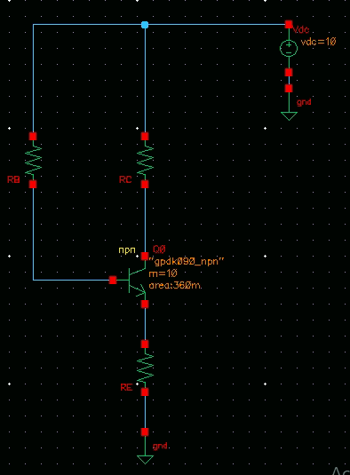
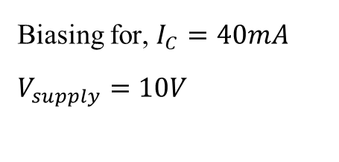
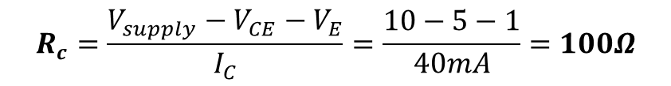
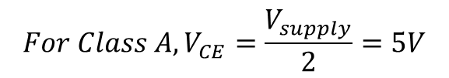
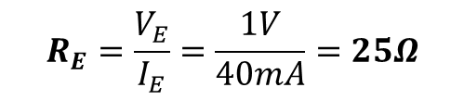
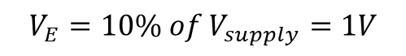
Biasing Circuit(Adjusting Q point)
Biasing for, $I_{C}=40mA$
$$V_{supply}=10V$$
$$V_{E}=10\% of V_{supply}=1V$$
$$R_{E}=\frac{V_{E}}{I_{E}}=\frac{1V}{40mA}=25Ω$$
$$For Class A, V_{CE}=\frac{V_{supply}}{2}=5V$$
$$R_{c}=\frac{V_{supply}−V_{CE}−V_{E}}{I_{C}}=\frac{10−5−1}{40mA}=100Ω$$
EEE 466 (2025) –Project Group 04
Presented by: 20060068

Slide 11
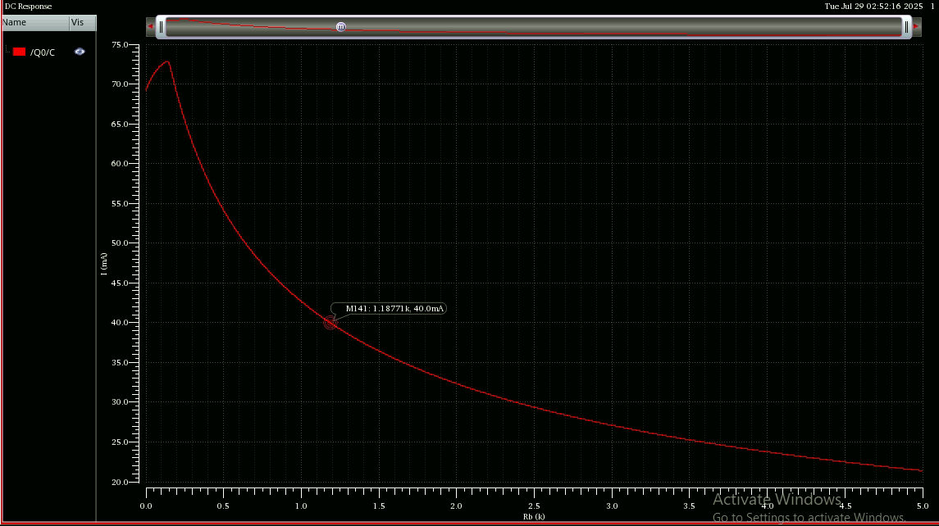
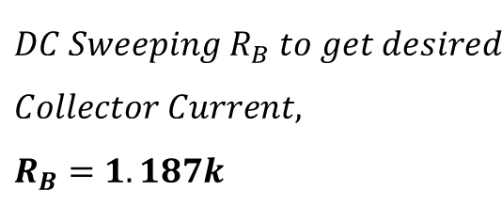
Biasing Circuit(Adjusting Q point)
$$DC Sweeping{ R}_{B} to get desired \\ Collector Current, \\ R_{B}=1.187k$$
EEE 466 (2025) –Project Group 04
Presented by: 20060068

Slide 12
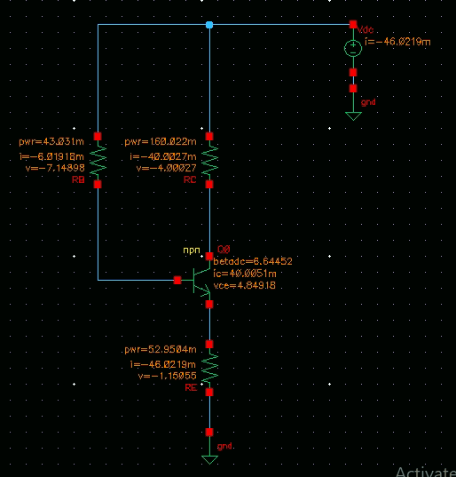
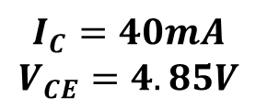
Biasing Circuit(Adjusting Q point)
$$I_{C}=40mA$$
$$V_{CE}=4.85V$$
EEE 466 (2025) –Project Group 04
Presented by: 20060068

Slide 13
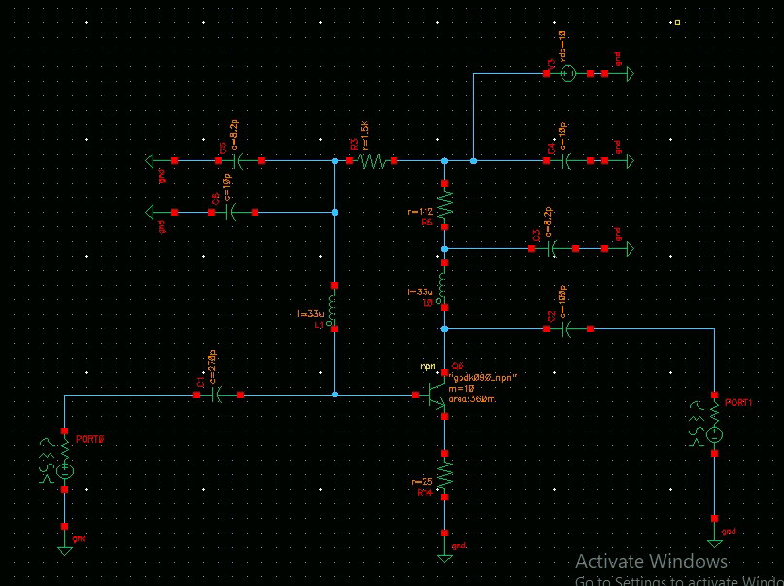
3.3 Design: Circuit Diagram (Without Matching Network)
EEE 466 (2025) –Project Group 04
Presented by: 20060068

Slide 14
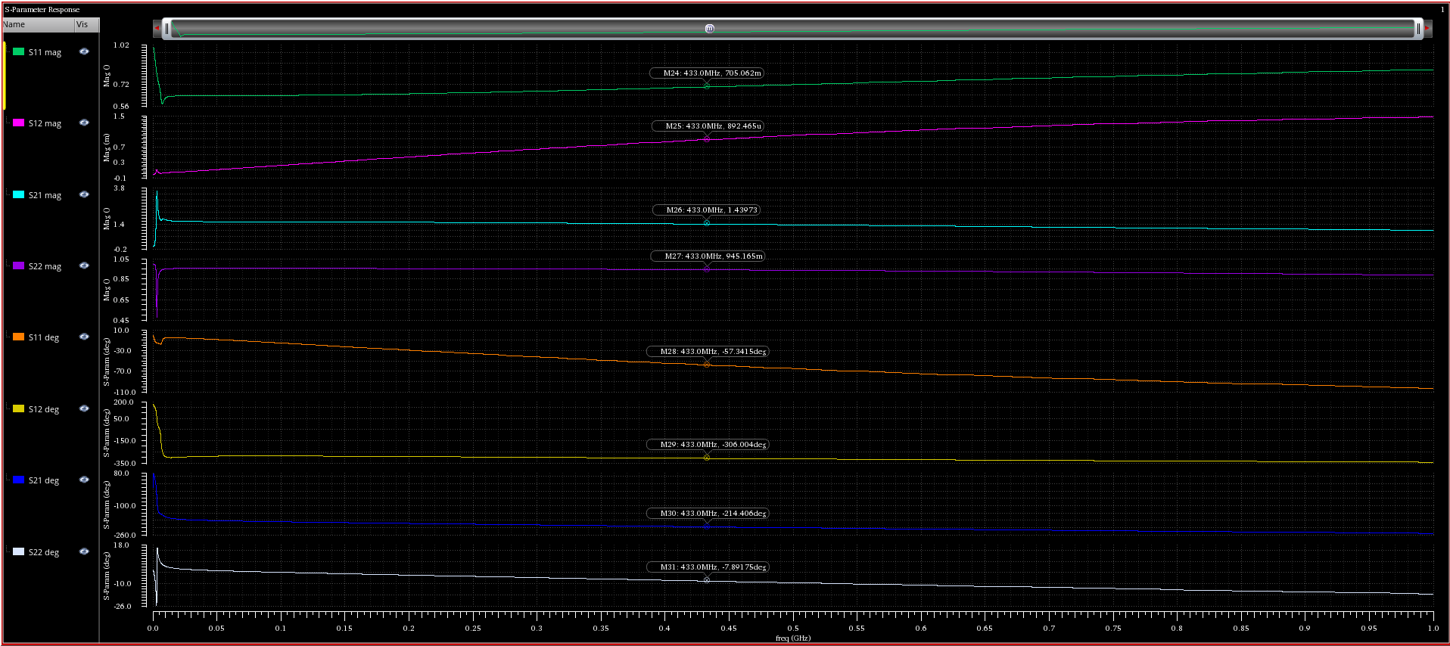

S parameters (without matching network)
$$S_{21}=3.16dB$$
Presented by: 20060068

Slide 15
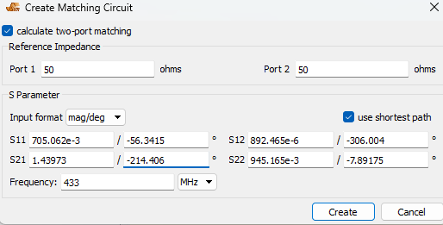
Designing Matching Network(QUCS Studio):
Fig : QUCS Studio Matching Network Tools
EEE 466 (2025) –Project Group 04
Presented by: 20060068

Slide 16
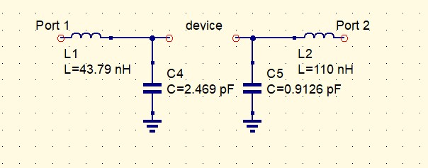
Designing Matching Network(QUCS Studio):
Fig : Matching Network Tools
EEE 466 (2025) –Project Group 04
Presented by: 20060068

Slide 17
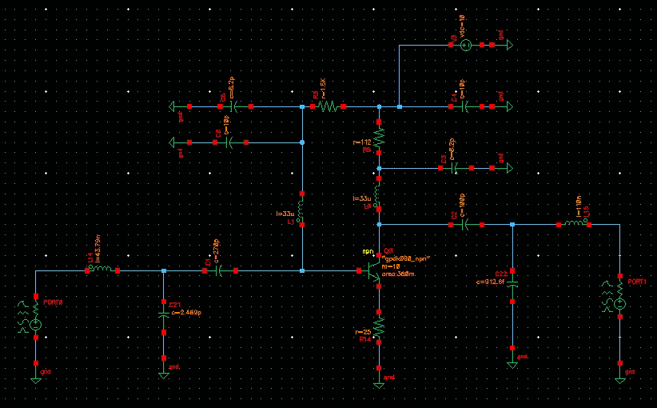
Class A Power Amplifier (Matching Network):
EEE 466 (2025) –Project Group 04
Presented by: 20060090

Slide 18
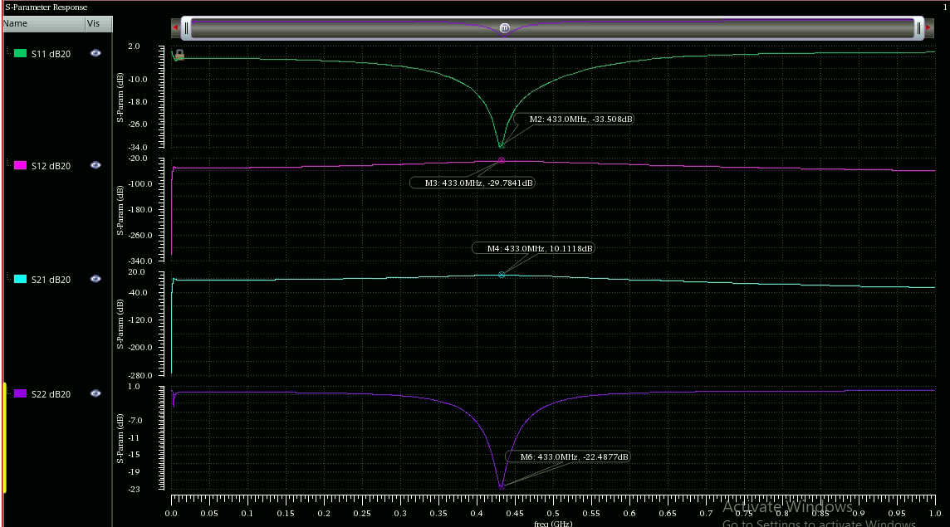
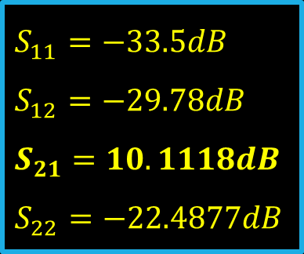
S parameter (With Matching Network):
$$S_{11}=−33.5dB$$
$$S_{12}=−29.78dB$$
$$S_{21}=10.1118dB$$
$$S_{22}=−22.4877dB$$
EEE 466 (2025) –Project Group 04
Presented by: 20060090

Slide 19
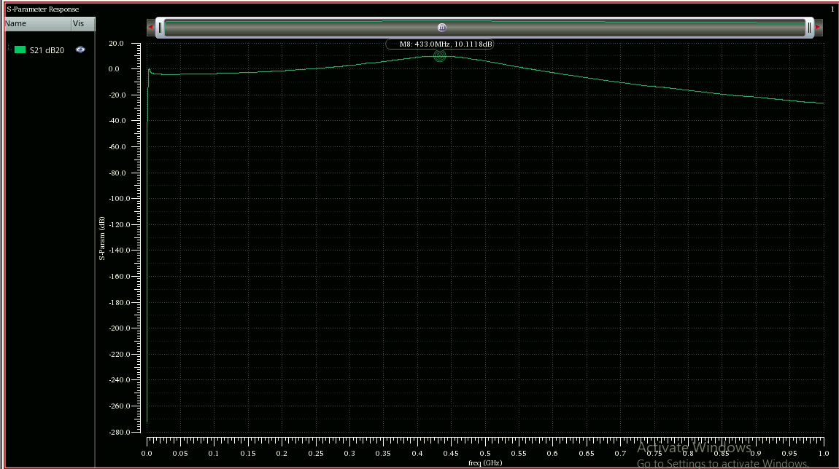
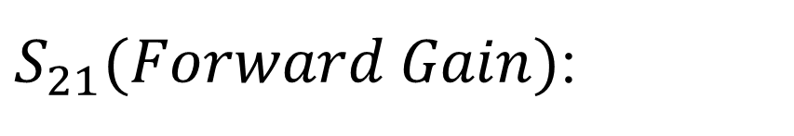

$S_{21}(Forward Gain)$:
$$S_{21}=10.1118dB$$
EEE 466 (2025) –Project Group 04
Presented by: 20060090

Slide 20
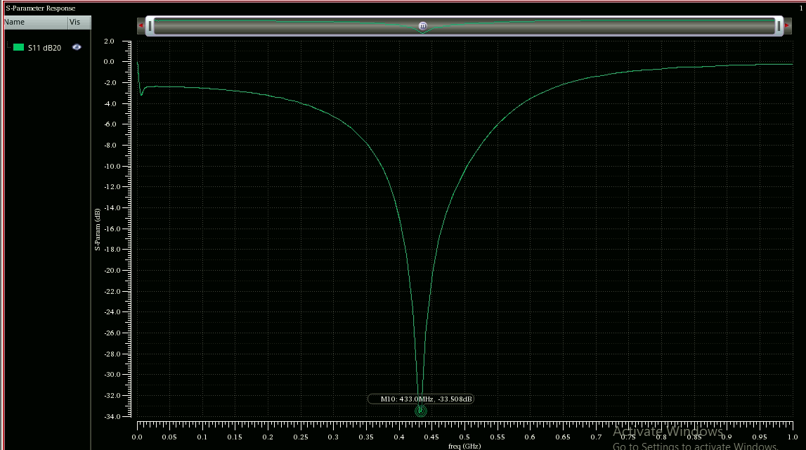
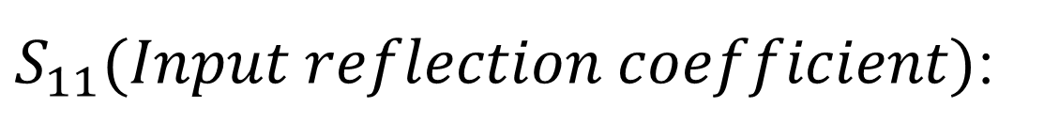

$S_{11}(Input reflection coefficient)$:
$$S_{11}=−33.508dB$$
EEE 466 (2025) –Project Group 04
Presented by: 20060090

Slide 21
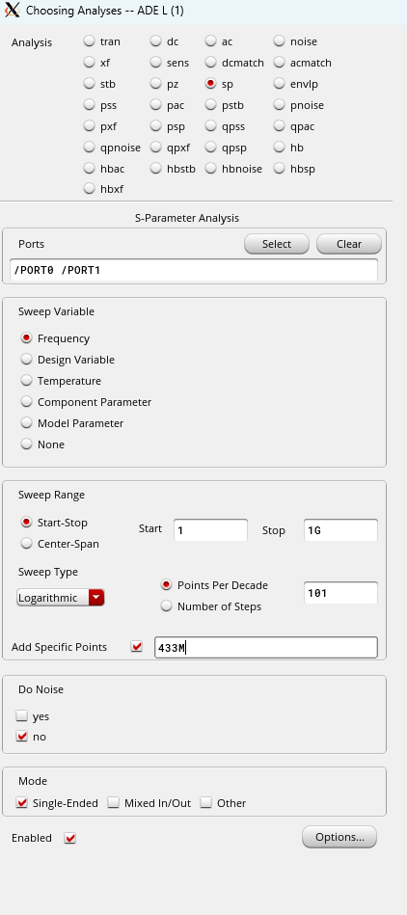
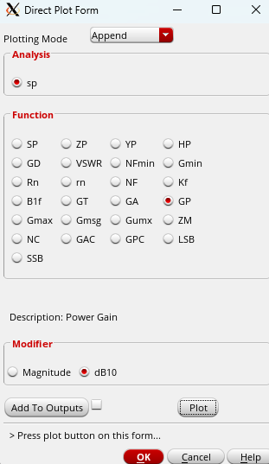
Power Gain:
EEE 466 (2025) –Project Group 04
Presented by: 20060090

Slide 22
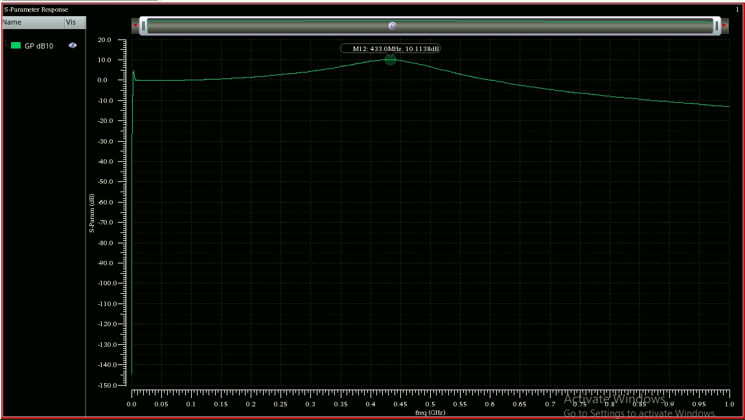

Power Gain:
$$Power Gain=10.1138dB$$
Power Gain = 10.1138dB
EEE 466 (2025) –Project Group 04
Presented by: 20060090

Slide 23
$$P_{sat} Analysis$$
Presented by: 20060090

Slide 24
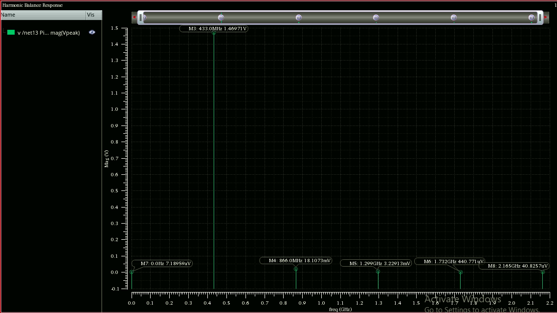
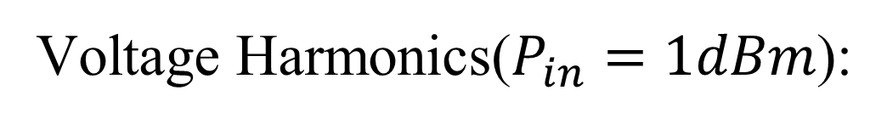
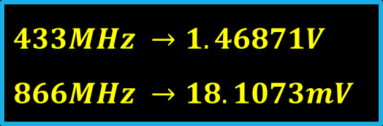
Voltage Harmonics($P_{in}=1dBm$):
$$433MHz →1.46871V \\ 866MHz →18.1073mV$$
EEE 466 (2025) –Project Group 04
Presented by: 20060090

Slide 25
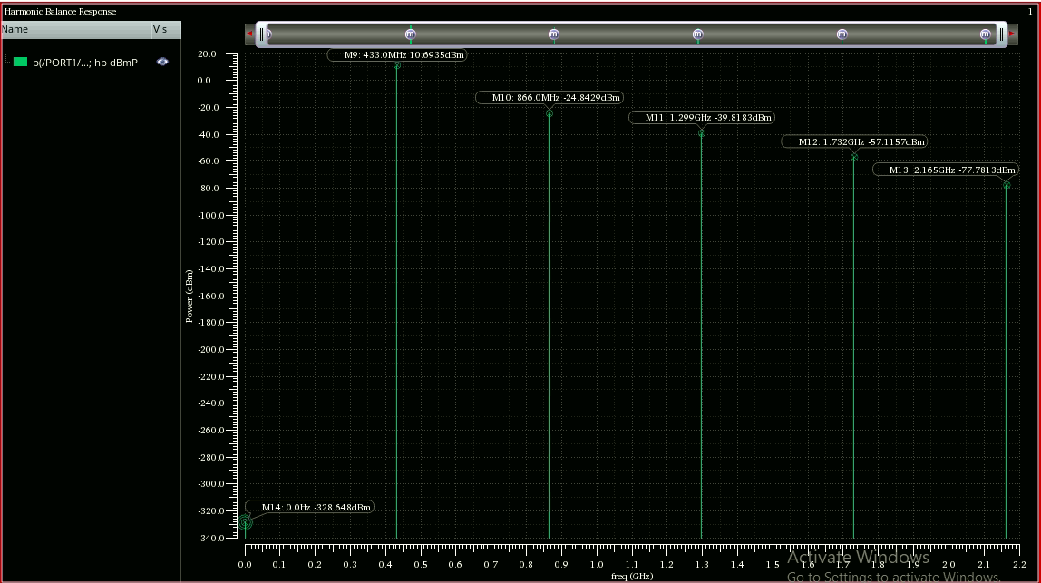
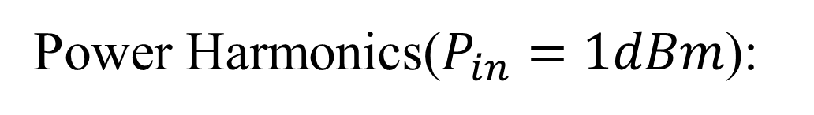
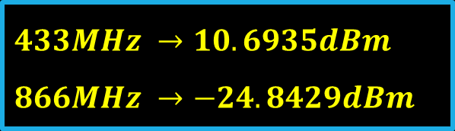
Power Harmonics($P_{in}=1dBm$):
$$433MHz →10.6935dBm \\ 866MHz →−24.8429dBm$$
EEE 466 (2025) –Project Group 04
Presented by: 20060090

Slide 26
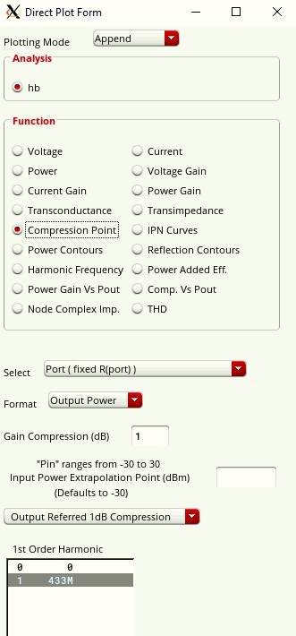
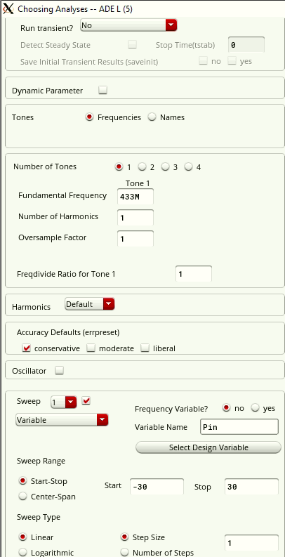
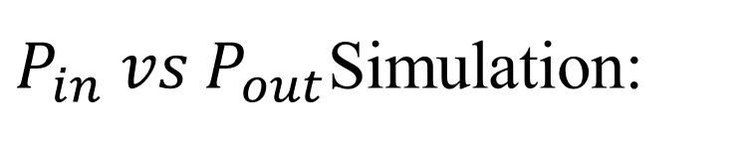
$P_{in} vs{ P}_{out}$Simulation:
433MHz
EEE 466 (2025) –Project Group 04
Presented by: 20060090

Slide 27
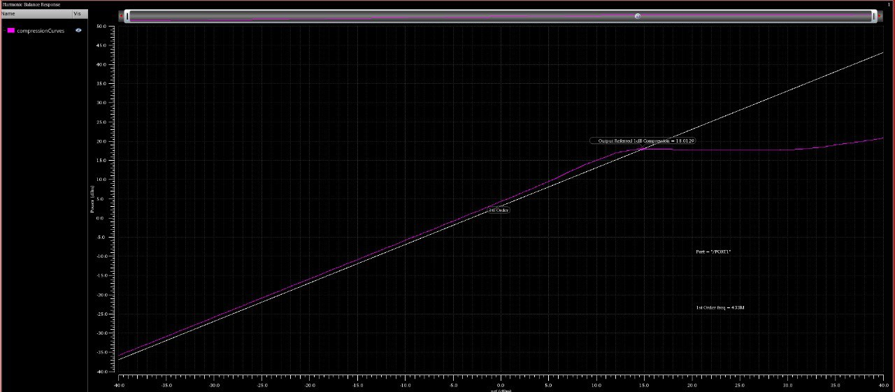

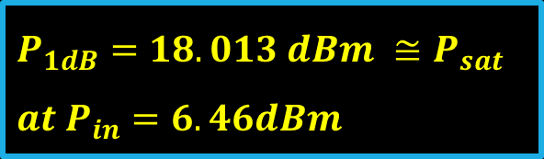
$$P_{out} vs{ P}_{in}:$$
$$P_{1dB}=18.013 dBm ≅P_{sat} \\ at P_{in}=6.46dBm$$
EEE 466 (2025) –Project Group 04
Presented by: 20060090

Slide 28

$$PAE Analysis$$
Presented by: 20060090

Slide 29
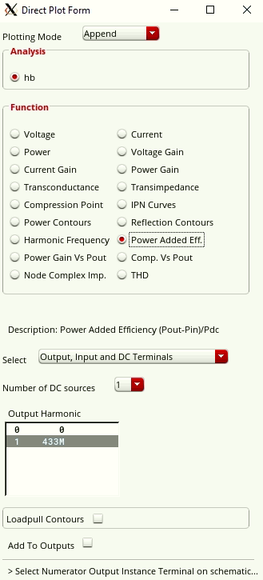

$PAE$ Simulation:
433MHz
EEE 466 (2025) –Project Group 04
Presented by: 20060090

Slide 30
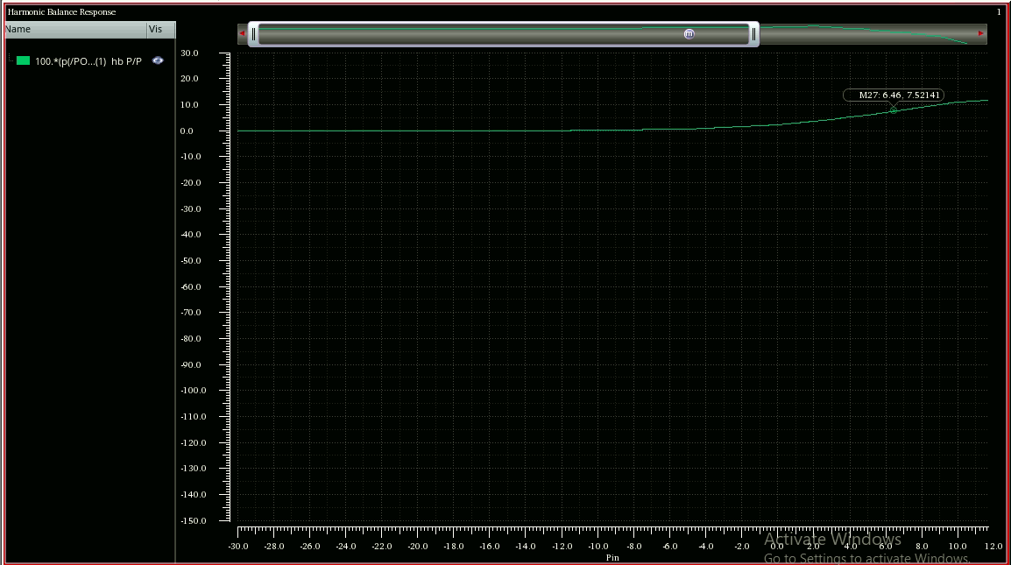


$PAE$ (Simulation):
$$PAE=7.52141\%$$
EEE 466 (2025) –Project Group 04
Presented by: 20060090

Slide 31
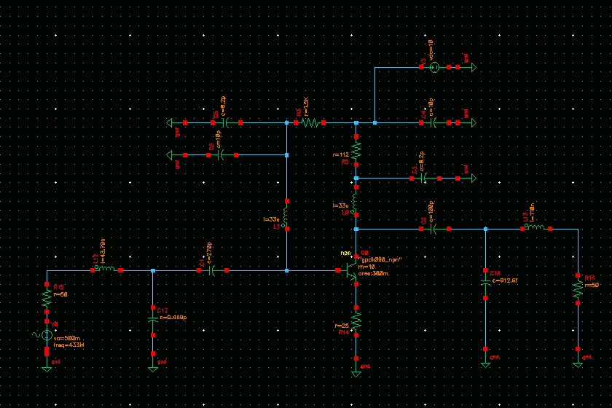
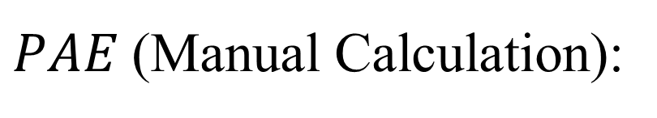
$PAE$(Manual Calculation):
EEE 466 (2025) –Project Group 04
Presented by: 20060116

Slide 32
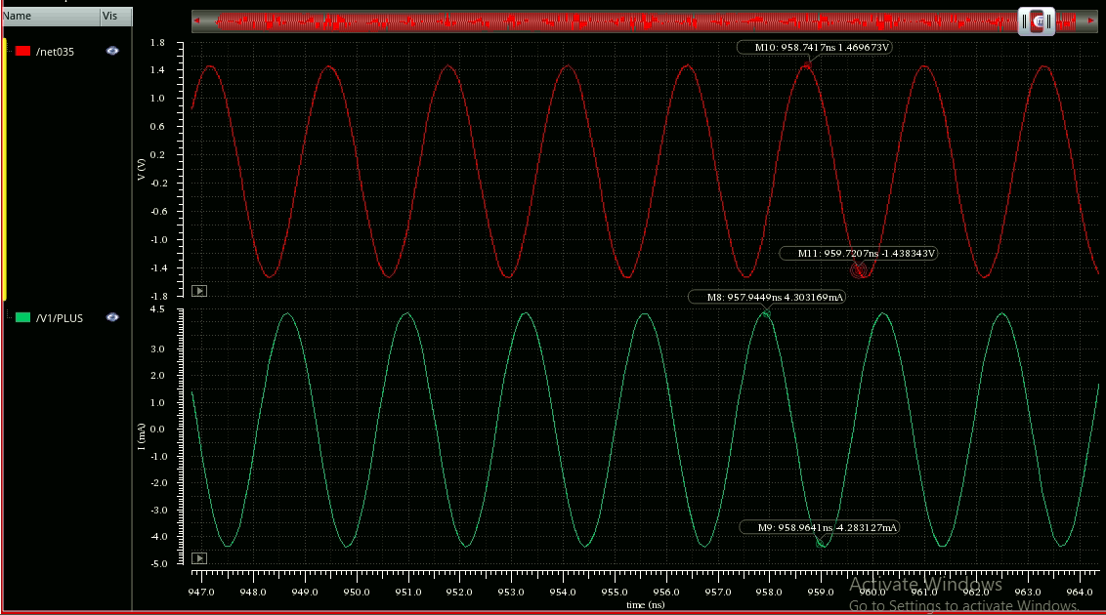
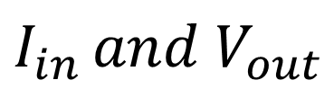
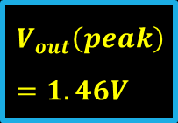
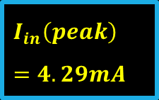


$$I_{in }and V_{out}$$
$$V_{out}$$
$$V_{out}\left(peak\right)=1.46V$$
$$I_{in}$$
$$I_{in}\left(peak\right)=4.29mA$$
Pin = 0.5*4.33m/2=1.0825mW Pout = 21.6678mW
EEE 466 (2025) –Project Group 04
Presented by: 20060116

Slide 33
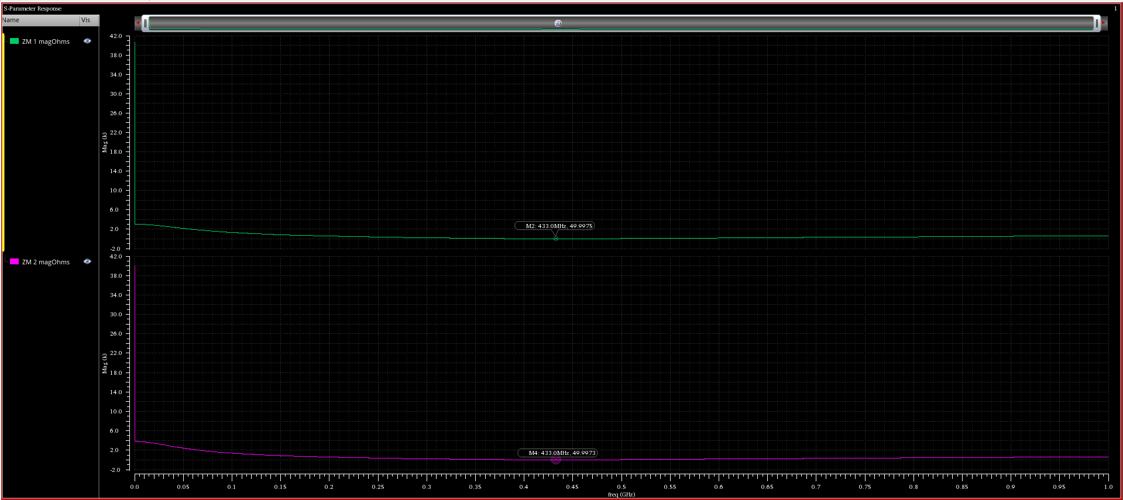


Input and Output Impedance:
$$Input Impedance, ZM1=49.9975Ω$$
$$Output Impedance, ZM2=49.9973Ω$$
Presented by: 20060116

Slide 34
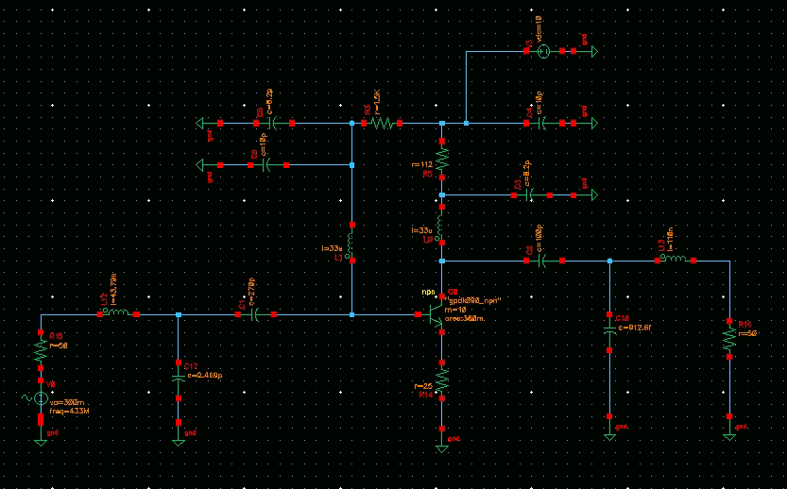


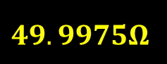
PAE (Manual Calculation):
$$49.9975Ω$$
$$I_{in}$$
+ $$V_{out}$$
-
EEE 466 (2025) –Project Group 04
Presented by: 20060116

Slide 35
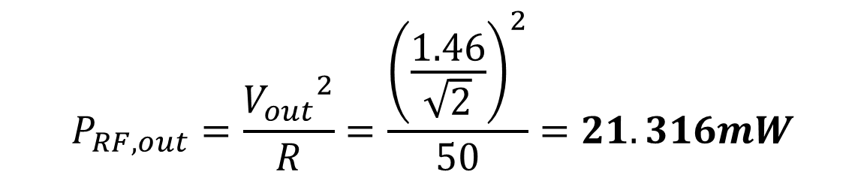
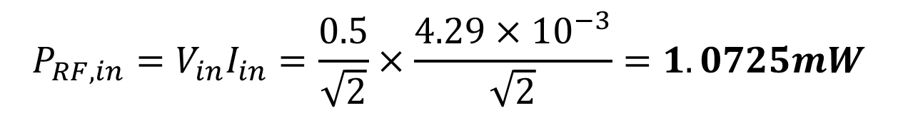
$$P_{RF,in}=V_{in}I_{in}=\frac{0.5}{\sqrt{2}}×\frac{4.29×{10}^{−3}}{\sqrt{2}}=1.0725mW$$
$$P_{RF,out}=\frac{{V_{out}}^{2}}{R}=\frac{{\left(\frac{1.46}{\sqrt{2}}\right)}^{2}}{50}=21.316mW$$
EEE 466 (2025) –Project Group 04
Presented by: 20060116

Slide 36
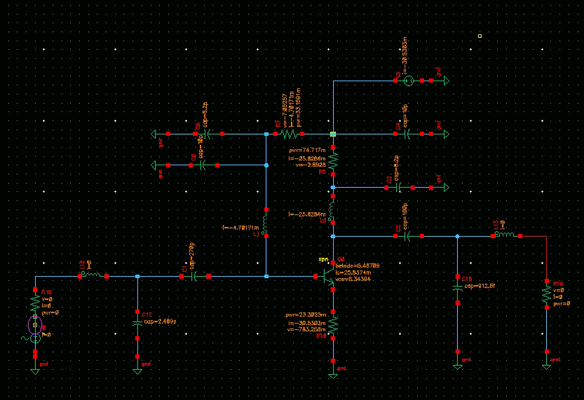

$DC$ Simulation:
+ $$V_{out}$$
-
EEE 466 (2025) –Project Group 04
Presented by: 20060116

Slide 37

$$P_{DC}=V_{dc}I_{dc}=10×30.5303×{10}^{−3}=305.303mW$$
$PAE=\frac{{P_{RF,out }−P}_{RF,in}}{P_{DC}}=$ $\frac{21.316−1.0725}{305.303}=6.63\%$
EEE 466 (2025) –Project Group 04
Presented by: 20060116

Slide 38
5.1 Novelty
Novelty Aspect | Details
Inductor- Integration | Improves stability and reduces noise, enhancing performance.
Optimization for 433 MHz ISM Band | Tailored for the specific challenges of the 433 MHz frequency range.
Impedance Matching Network | Custom matching network designed using S-parameters to enhance power transfer efficiency.
Simulation and Real-World Testing | Combines Cadence Virtuoso simulations with practical design validation.
Low-Power, High-Efficiency Design | Focus on optimizing PAE and thermal stability for IoT and sensor applications.
EEE 466 (2025) –Project Group 04
Presented by: 20060116

Slide 39

5.2 comparison table of target and achieved specifications.
Parameter | Value (Required ) | Value (Achived )
Frequency | 433 MHz | 433MHz
Gain | ≥ 10 dB | 10.1138dB
Power-Added Efficiency (PAE) | ≥ 5% | 7.5%
Saturation Power (Psat) | ≥ 17 dBm | $18.01$dBm
Technology | gpdk090 or tsmc18 | gpdk090
Presented by: 20060116

Slide 40
8. Future Work (PO(l))
Integration with Advanced Modulation Techniques
Optimization for Multi-Stage Amplifiers
Thermal and Power Efficiency Enhancement
Presented by: 20060116

Slide 41
6. Reflection on Individual and Team work
Phase | Duration | Activities | Responsible Members
Phase 1 | Week 8 | Literature Review, Background | Ilias(68), Rifat(116), Hosan(90), Alamgir(122)
Phase 2 | Week 9 | Circuit Design and Simulation in Cadence Virtuoso | Ilias, Rifat, Hosan
Phase 3 | Week 10 | S-parameters Extraction and Analysis, Matching Network Design in QUCS Studio | Hosan, Alomgir, Rifat
Phase 4 | Week 11 | Optimization and Tuning of Matching Network | Rifat, Alomgir, Ilias
Phase 5 | Week 12 | Testing and Validation of the Amplifier | Ilias, Rifat, Hosan
Phase 6 | Week 13 | Final Adjustments, Documentation, Presentation and Final Report Writing | Ilias, Rifat, Hosan, Alomgir
Presented by: 20060116

Slide 42
7 Communication to External Stakeholders (PO(j))
Github Link
YouTube Link
Presented by: 20060116

Slide 43
9. CO/PO Alignment
CO(s) | Key Contributions | Aligned PO(s)
CO1, CO2 | Application of semiconductor physics in analog circuit design and analysis of IC operation based on physics and control theory. | PO(a), PO(b)
CO3, CO4 | Designing solid-state integrated circuits and verifying performance using circuit simulation tools for complex device models. | PO(c), PO(e)
CO5, CO6 | Demonstrating effective teamwork and presenting designed analog devices/systems through interactive discussions and project presentations. | PO(i), PO(j)
CO7 | Applying skills in the design and presentation of Analog Integrated Devices/Systems, focusing on communication and design synthesis. | PO(j)
Presented by: 20060116

Slide 44
10. References
NXP Semiconductors, BFU590Q ISM 433 MHz PA Design Application Note (AN11504), NXP Semiconductors, 2014.
Analog Devices, RF Power Amplifier Design Notes, May 2003. [Online]. Available: https://www.analog.com/media/en/training-seminars/tutorials/MT-101.pdf
İ. Kocakarin, “RF Power Amplifier Design Operating at 433 MHz,” B.Sc. thesis, Dept. of Electrical and Electronics Eng., Yeditepe Univ., Istanbul, Turkey, 2016. [Online]. Available: https://www.academia.edu/42443047
I. J. Bahl, Fundamentals of RF and Microwave Transistor Amplifiers, Wiley, 2003.
Presented by: 20060116

